Slide 1
Fast and Concurrent RDF Queries using RDMA-assisted GPU Graph Exploration
Siyuan Wang, Chang Lou, Rong Chen, Haibo Chen Institute of Parallel and Distributed Systems, Shanghai Jiao Tong University Contacts: {rongchen, haibochen}@sjtu.edu.cn
Xu Haining

Slide 2
Wukong+G
The ﬁrst graphbased distributed RDF query processing system that efﬁciently exploits the hybrid parallelism of CPU and GPU

Slide 3
Wukong+G
Three innovation points
utilizes GPU to tame random memory
introducing a GPUfriendly RDF store
scales out through a communication layer

Slide 4
Introduction
main parts in wukong +G
GPU-based query execution
GPU-friendly RDF store
Heterogeneous RDMA communication

Slide 5
BackGround
Hardware heterogeneity.
Compared to CPU, the number of GPU cores (threads) can easily exceed two thousand
Fast communication: GPUDirect with RDMA
This technique enables direct data transfer between GPUs by InﬁniBand NICs as the name suggests [2].

Slide 6
Why plus G
WuKong is incompetent when handle heavy queries efﬁciently.
Leads to suboptimal performance when facing hybrid workloads comprising both light and heavy queries

Slide 7
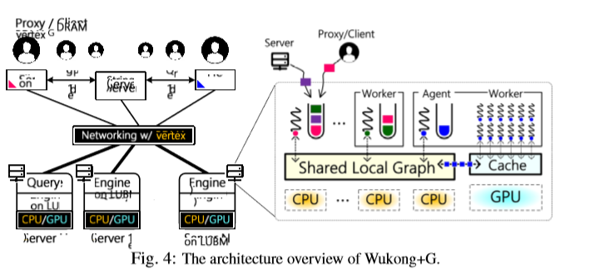
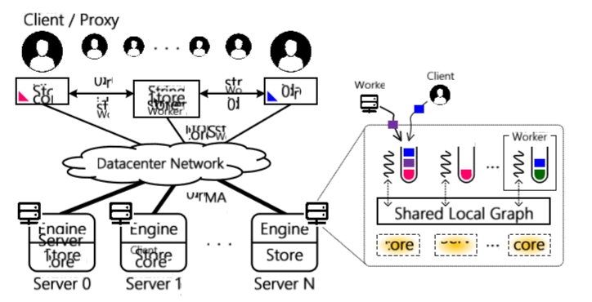
System architecture
One CPU core to run an agent thread; the agent thread will assist the worker threads on GPU cores to run queries

Slide 8
Challenges
C1:Small GPU memory
C2: Limited PCIe bandwidth

Slide 9
Efﬁcient Query Processing on GPU
Query-aware prefetching
Pattern-aware pipelining
Fine-grained swapping

Slide 10
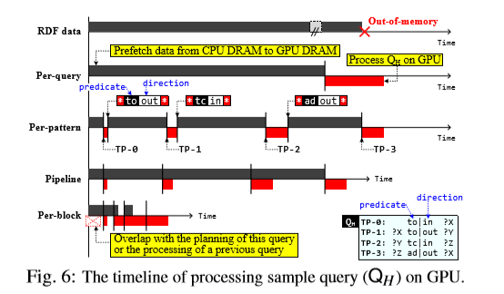
Query-aware prefetching

Slide 11
GPU-friendly RDF Store
Predicate-based grouping (CPU memory)
Pairwise caching (GPU memory).

Slide 12
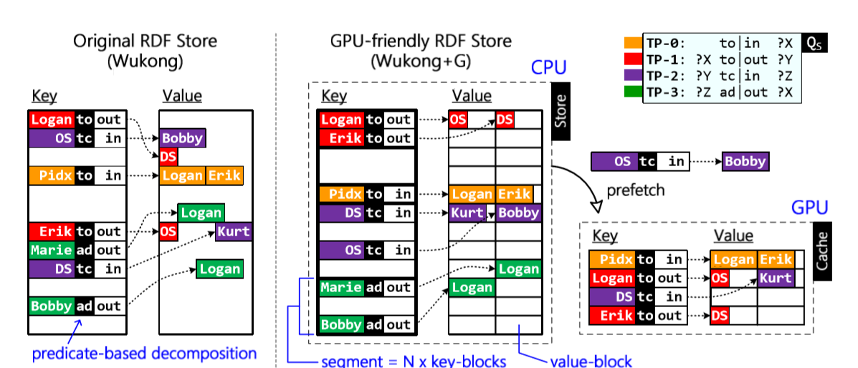
GPU-friendly RDF Store

Slide 13
Evaluation
Hardware conﬁguration:
10 servers on 5 machines.
Each server:
12-core Intel Xeon E5-2650 v4 CPU with 128GB of DRAM, one NVIDIA Tesla K40m GPU with 12GB of DRAM
one Mellanox ConnectX-3 56Gbps InﬁniBand NIC via PCIe 3.0 x8 connected to a Mellanox IS5025 40Gbps IB Switch.

Slide 14
Evaluation
Benchmarks:
The DBpedia’s SPARQL Benchmark (DBPSB) [1] and YAGO2 [6, 22]

Slide 15
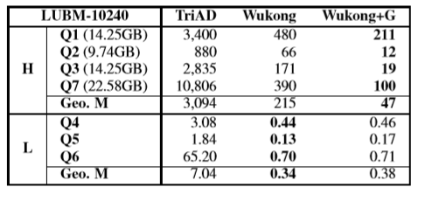
Performance of Hybrid Workload

Slide 16
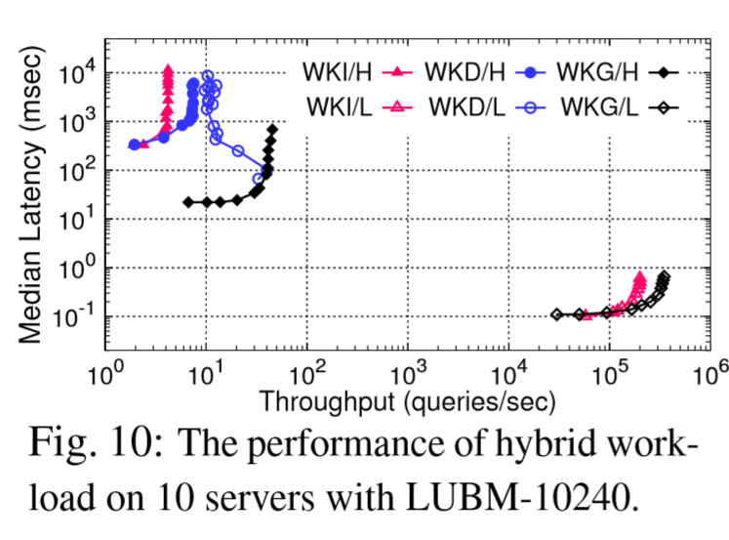
Single Query Performance

Slide 17
Thankyou

